Slide 1


Slide 2
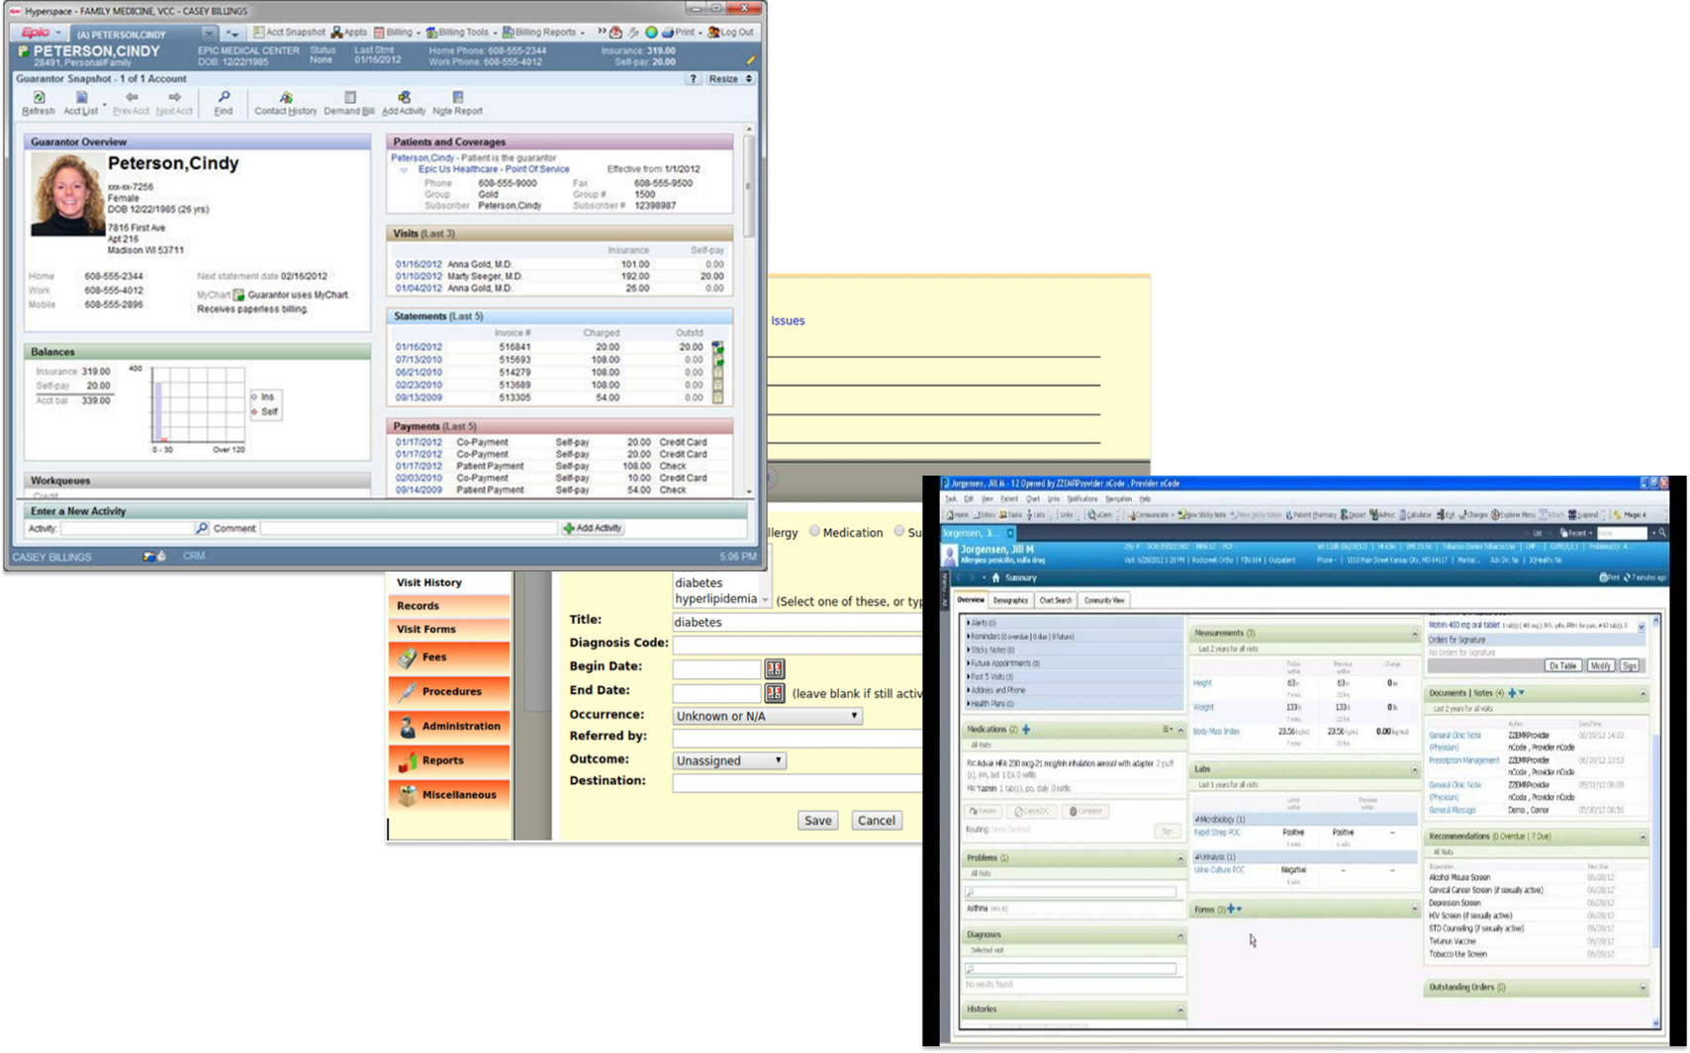
Why Vita Clinic?
Vita Clinic – Advanced Oncology Care

Slide 3
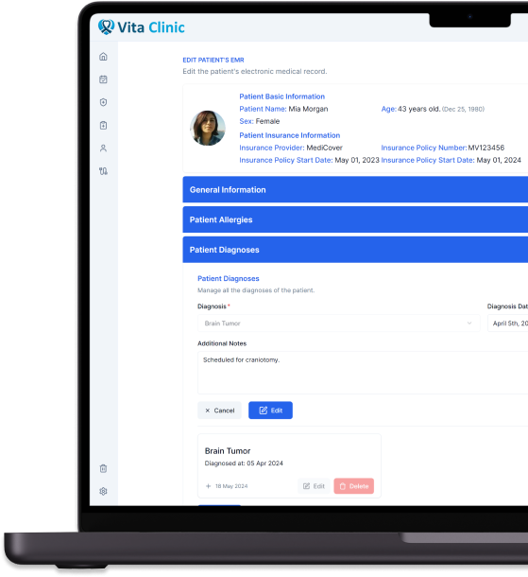

Introducing
Your All-in-One Platform for Advanced Oncology Care
Vita Clinic – Advanced Oncology Care

Slide 4
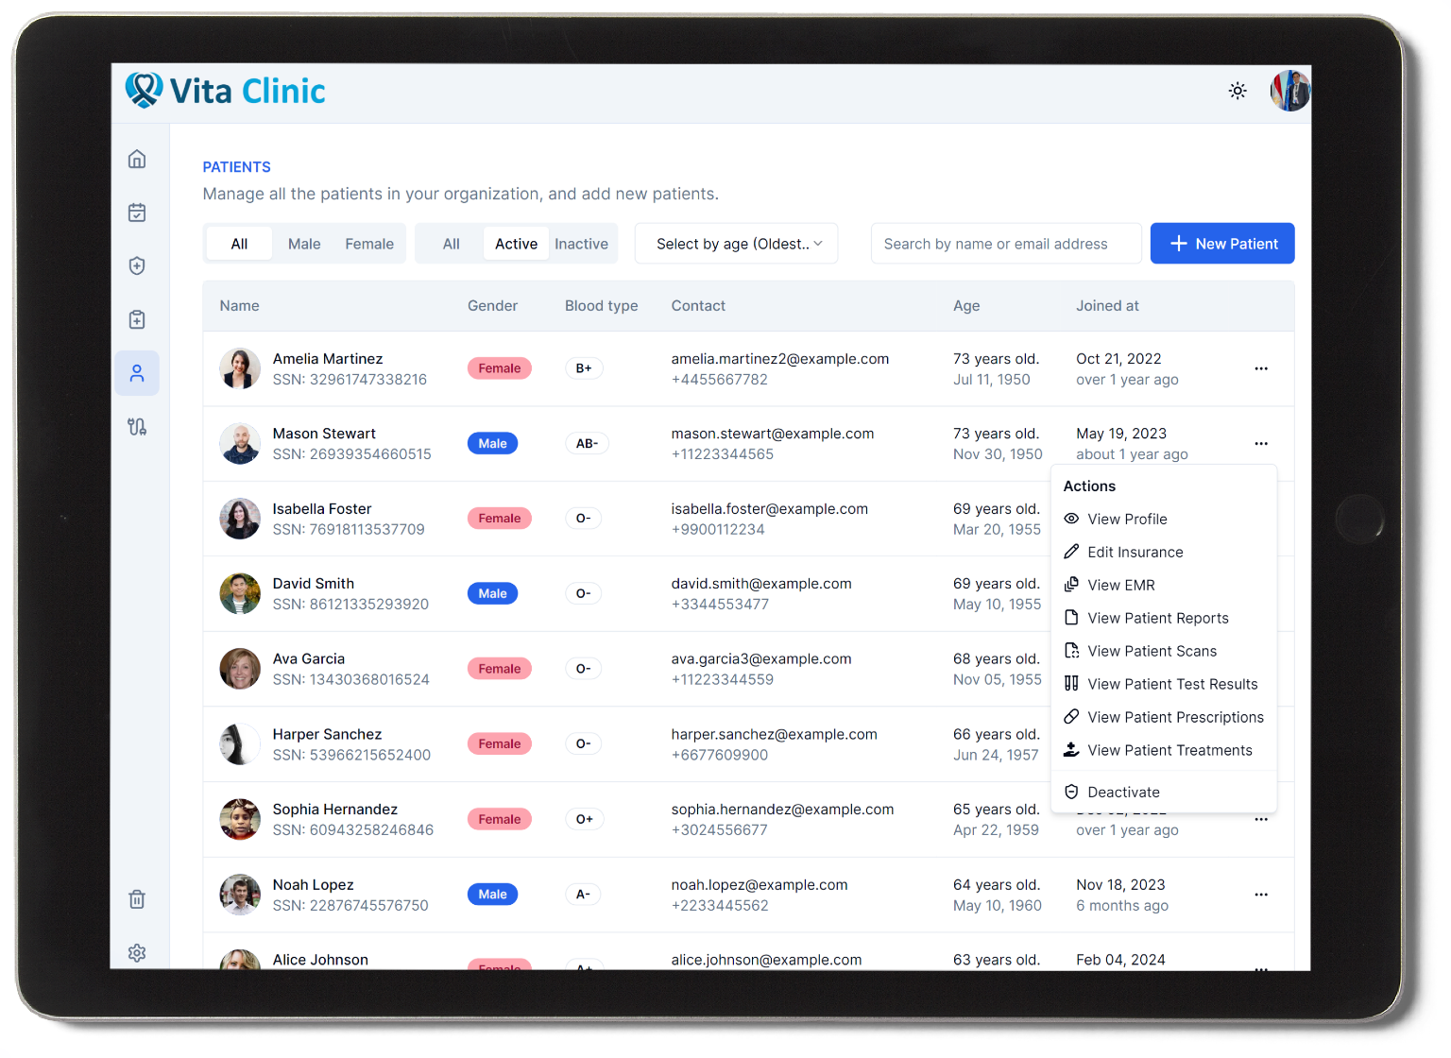
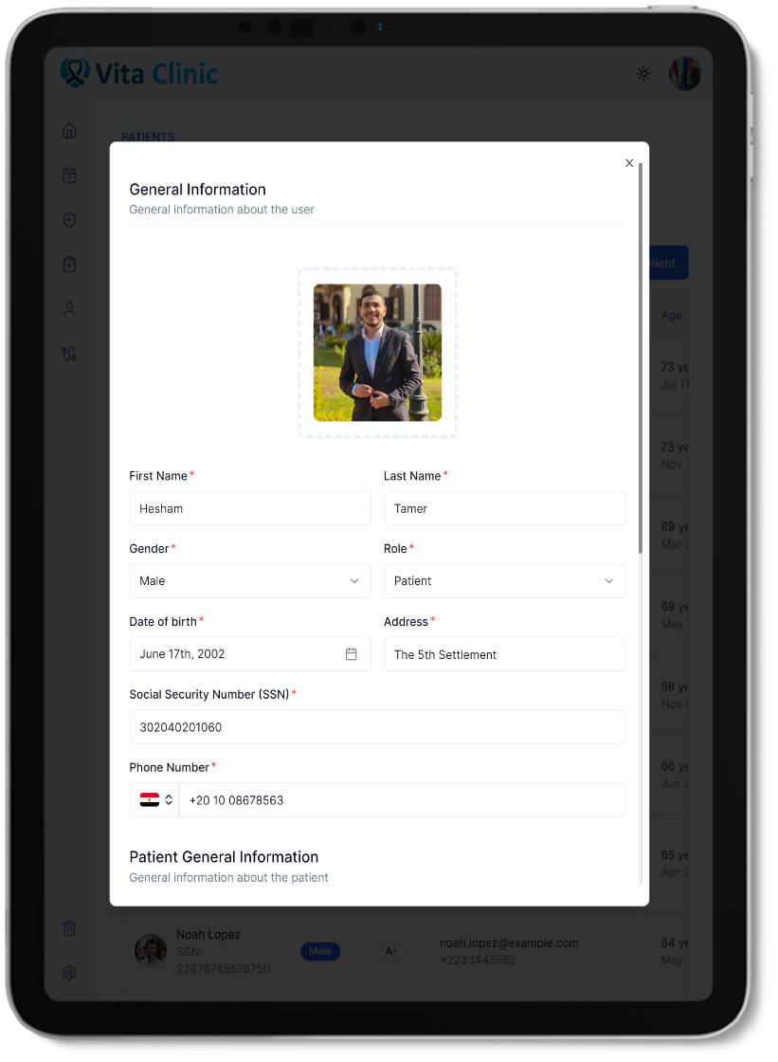
User Management
Vita Clinic – Advanced Oncology Care

Slide 5
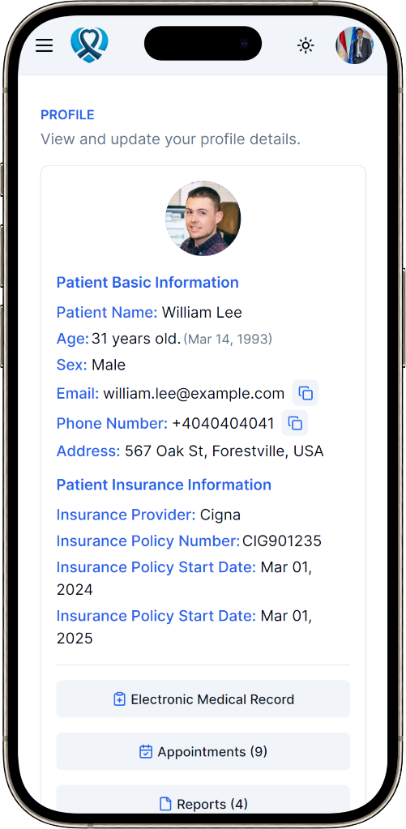
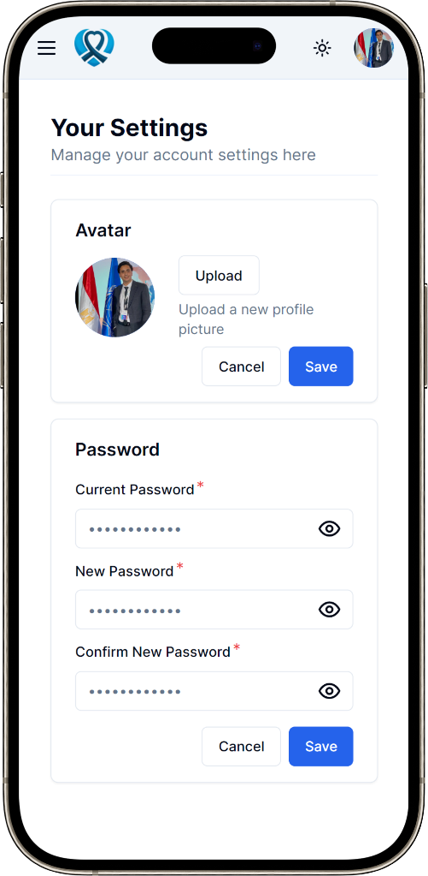



User Management
Different User Actions
User activation & deactivation, updating insurance details, changing doctors speciality, and managing patient’s EMR.
Advanced Filters and Sorting
Different types of filters and sorting techniques, all filters and sorting are server-side to ensure performance and stability.
Users Profile and Settings
You can view your users’ profiles, and you can update you own settings (i.e: Avatar & password).
Vita Clinic – Advanced Oncology Care

Slide 6
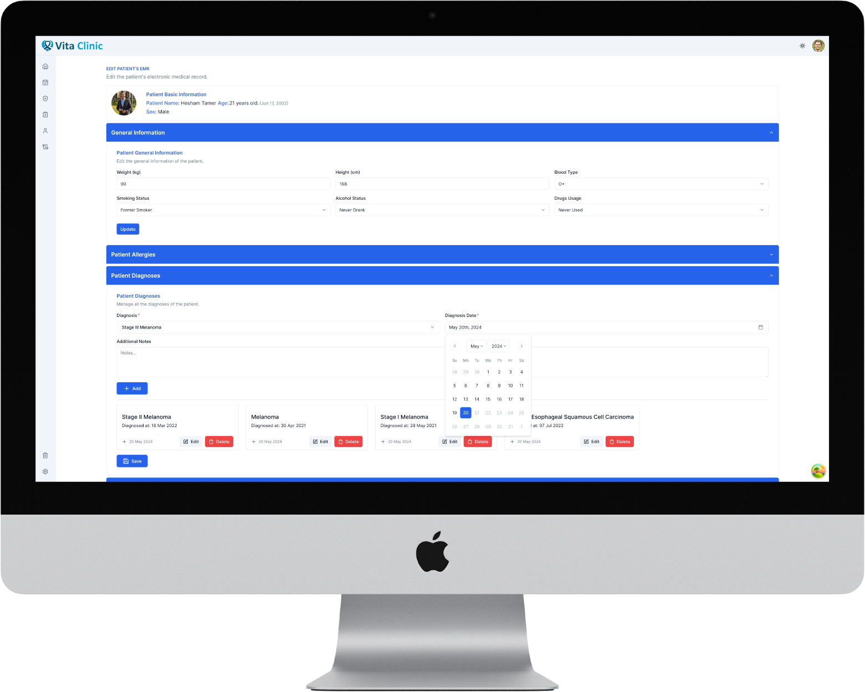
EMR System
Vita Clinic – Advanced Oncology Care

Slide 7
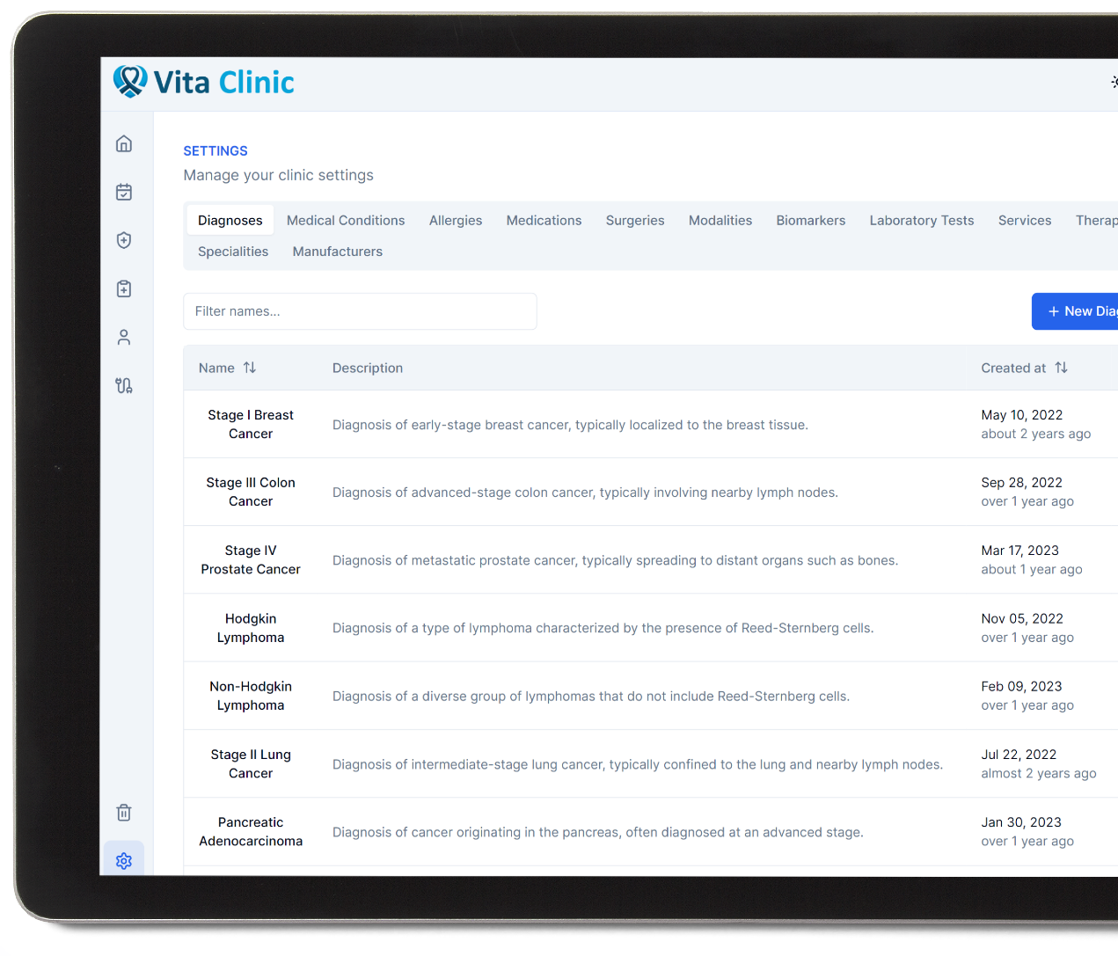



System-Wide Settings
Configure Possible Medical Data
Admins & doctors can view all possible diagnoses, medical conditions, surgeries, medications, and allergies. As well as creating new ones.
Change Services Prices
Admins can create new services provided by the clinic, and they can change the prices of already existing services.
Manage Device Manufacturers
Admins can configure devices manufacturers whom they purchase their devices from.
Vita Clinic – Advanced Oncology Care

Slide 8
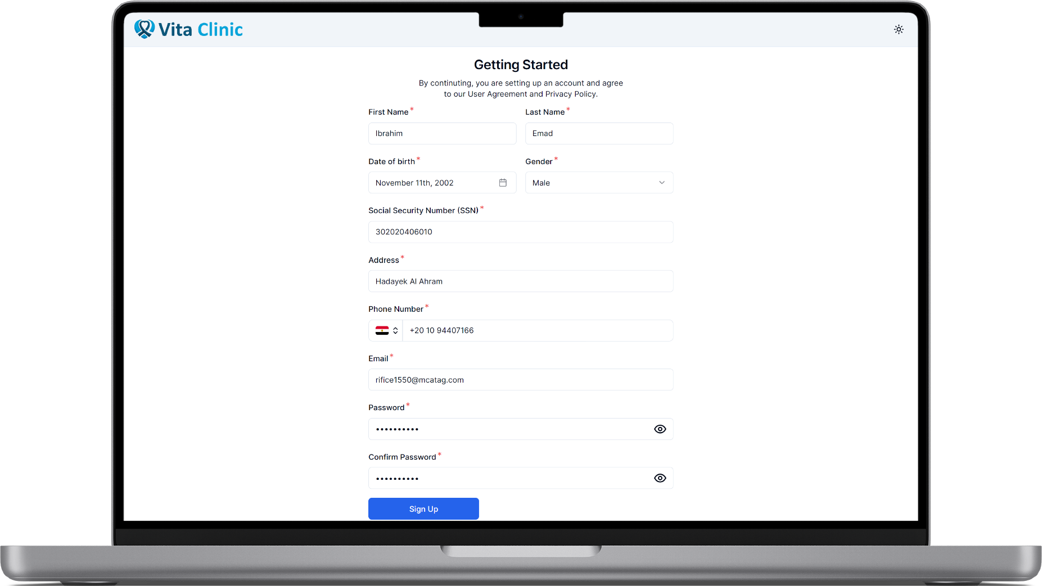
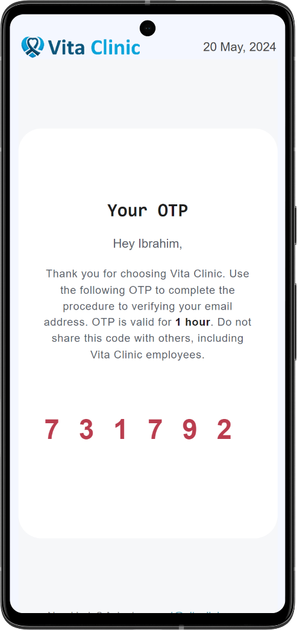
Patient Registration
Vita Clinic – Advanced Oncology Care

Slide 9
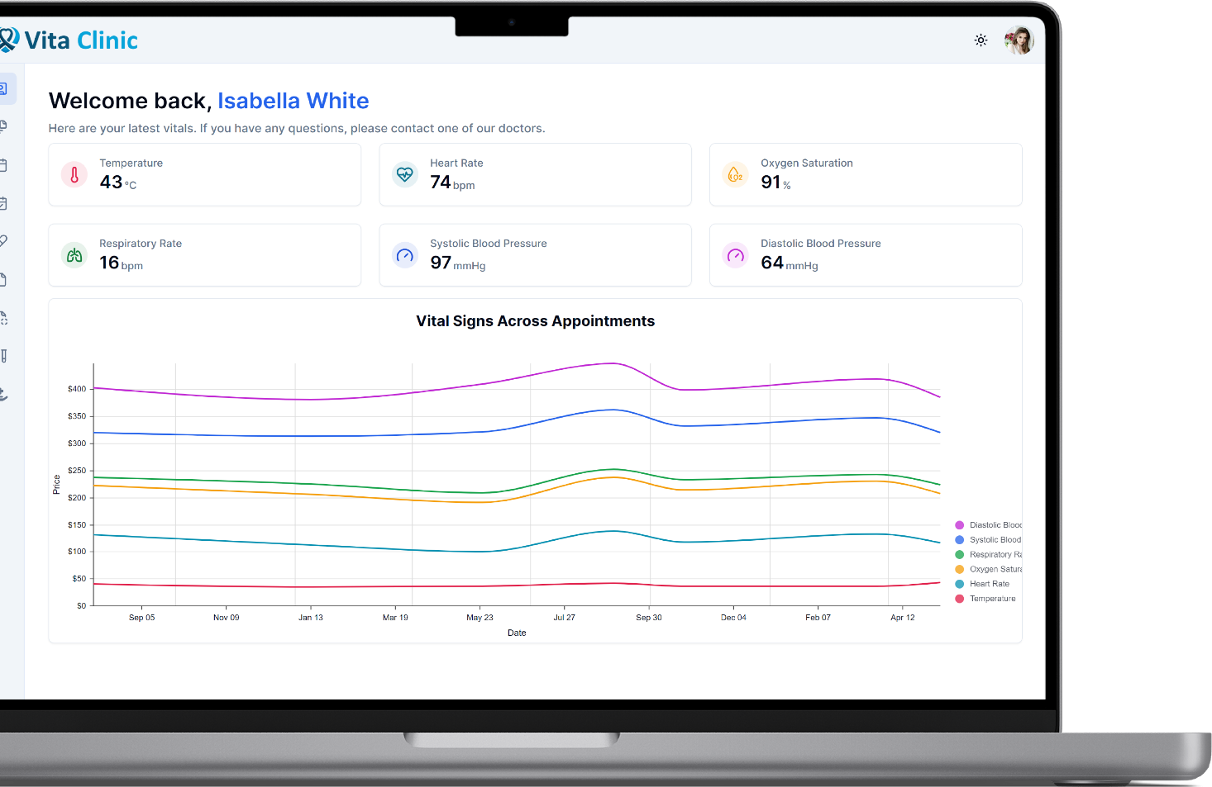



Patient Portal
View Previous Vitals
Patients can view their previous vitals across all different appointments, as long as they can see their latest vital signs.
View Medical Information
Patients can view their EMR, reports, prescriptions, laboratory test results, treatments, and scans.
Appointment Scheduling
Patients can schedule new appointments with the services they need, and they can monitor all their appointments.
Vita Clinic – Advanced Oncology Care

Slide 10
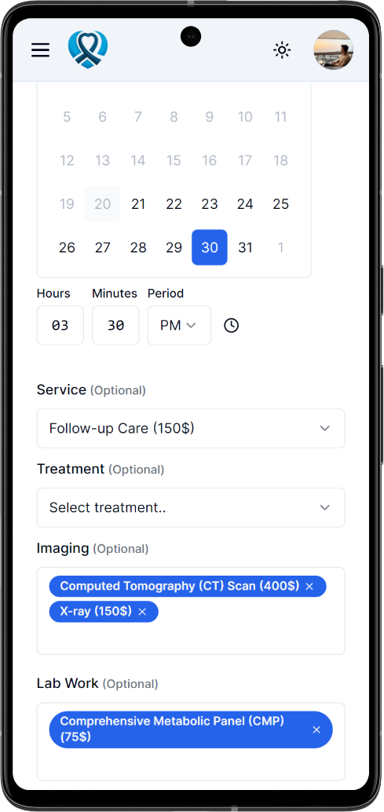
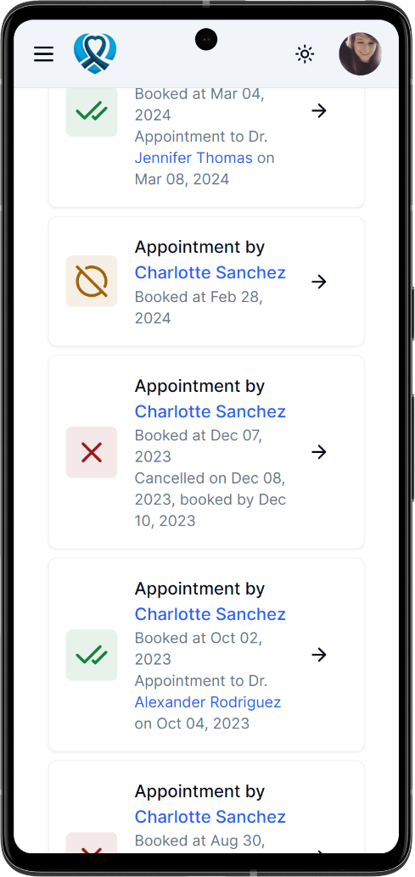

Appointment Scheduling
Flexible Appointment Scheduling
Patients can schedule their appointments flexibly, choosing exactly the services they need for their appointments.
Appointment Cost Monitoring
Patients can monitor the changes in their appointments cost according to any changes in services they need
View Appointments Status
Patients can view all their appointments, checking whether their appointments have been approved, rejected, cancelled, or anything else.
Vita Clinic – Advanced Oncology Care

Slide 11
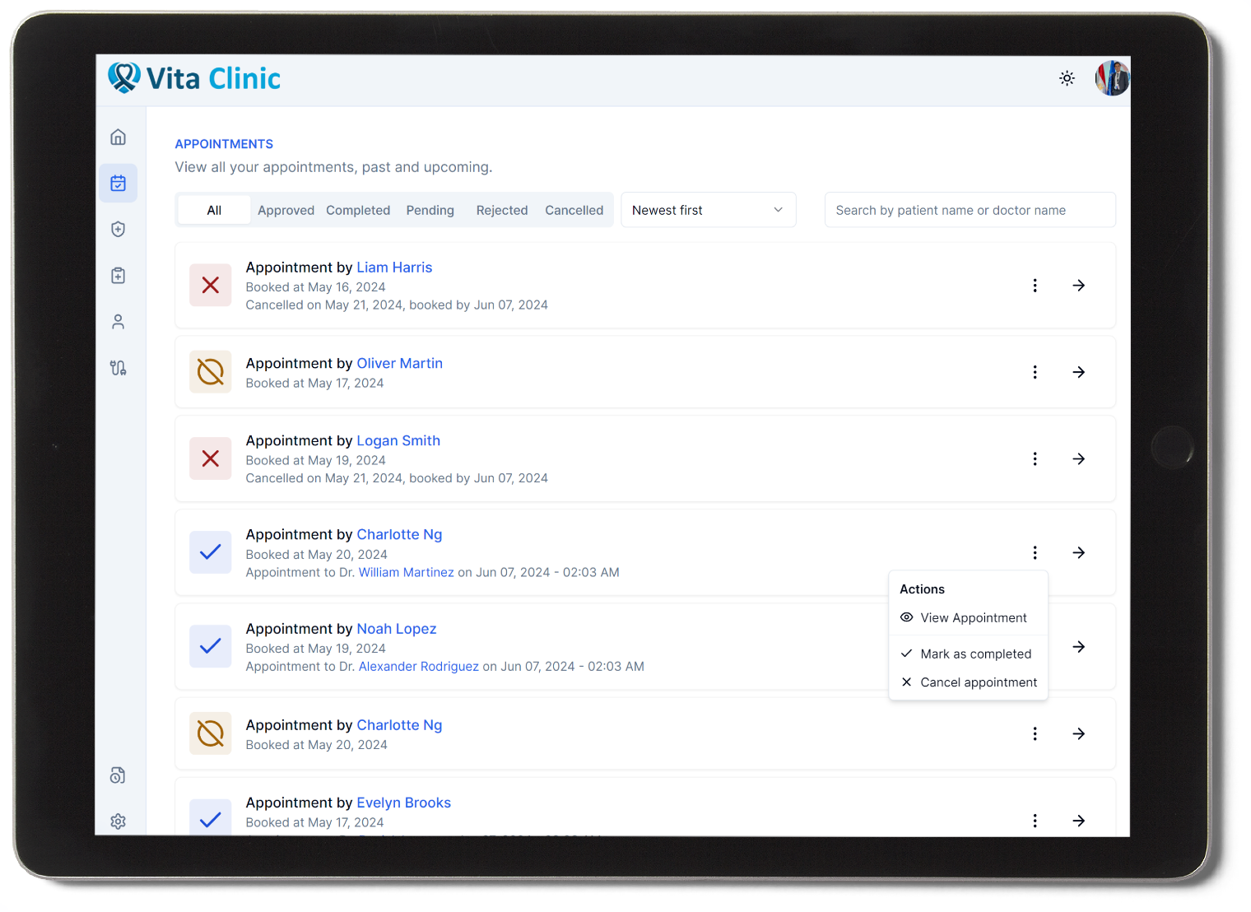
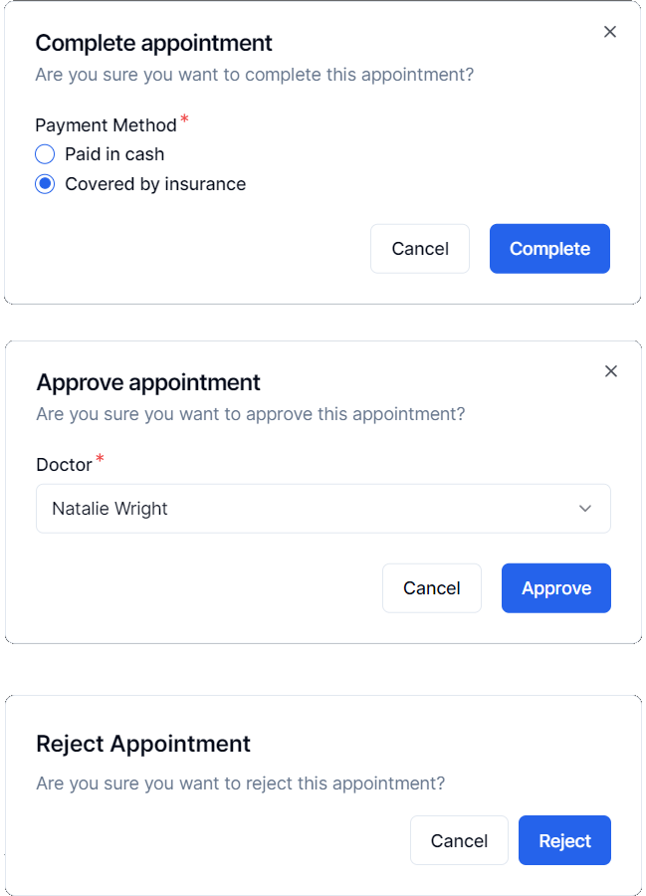
Appointments Management
Vita Clinic – Advanced Oncology Care

Slide 12
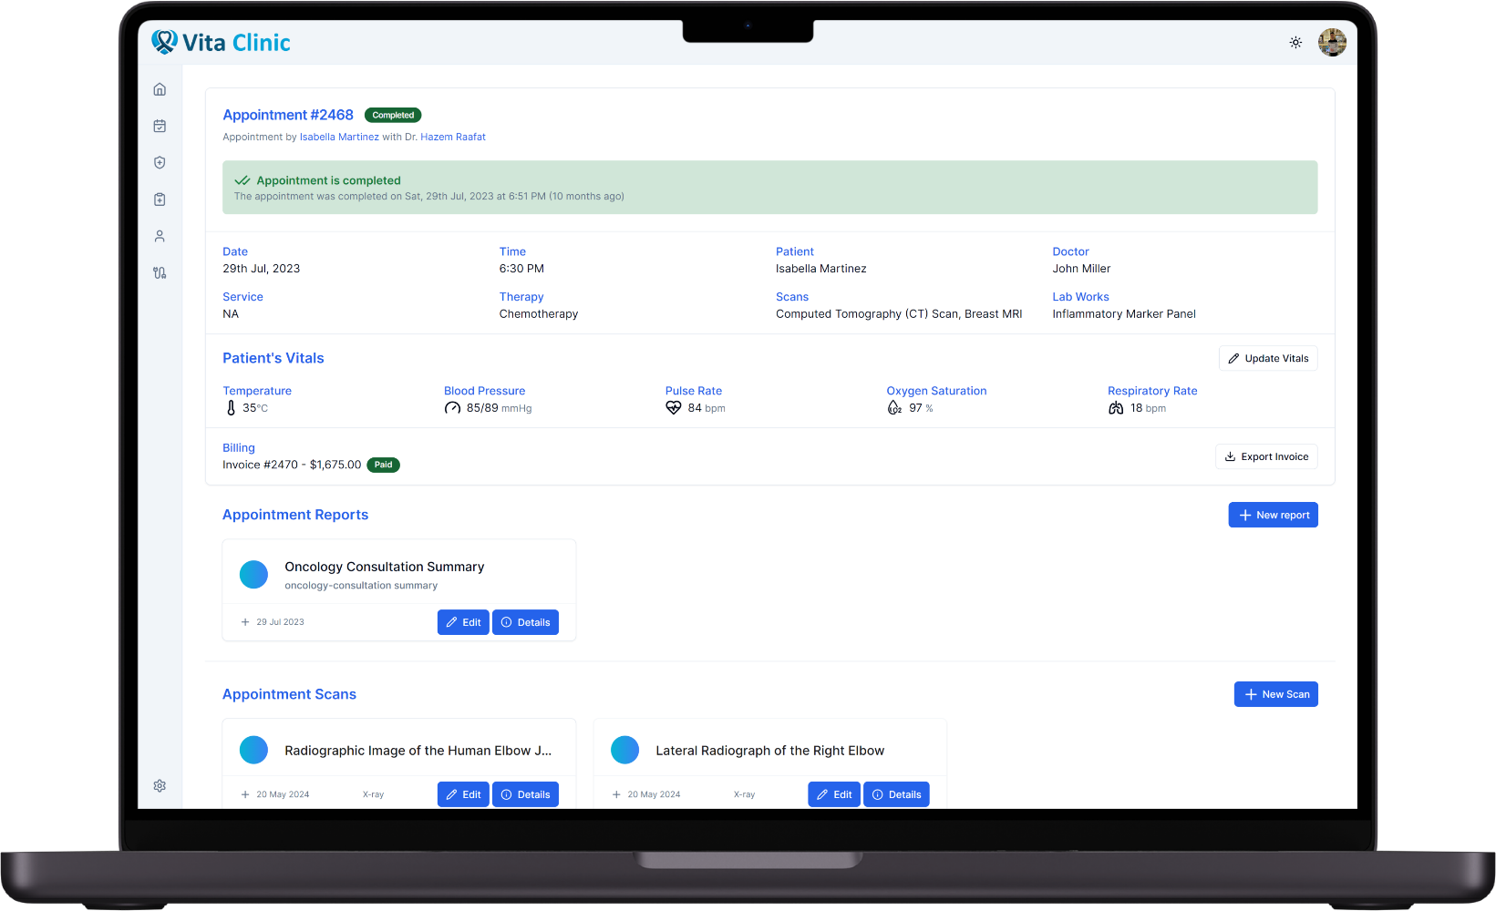



Appointments Management
Update Patient Vitals
Doctors can update patient vitals for each appointment they are assigned to.
Create Reports, Scans, Test Results
Doctors can create new reports, scans, or laboratory test results for patients in their appointments
Prescribe New Medications
Doctors can prescribe new medications to patients in their appointments, they can also create their treatment progress
Vita Clinic – Advanced Oncology Care

Slide 13
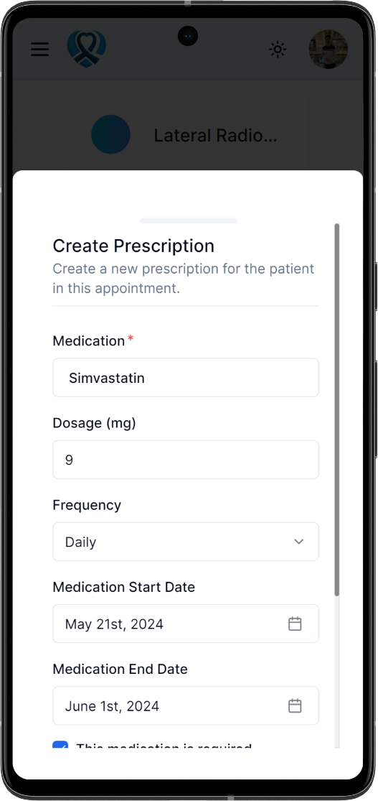
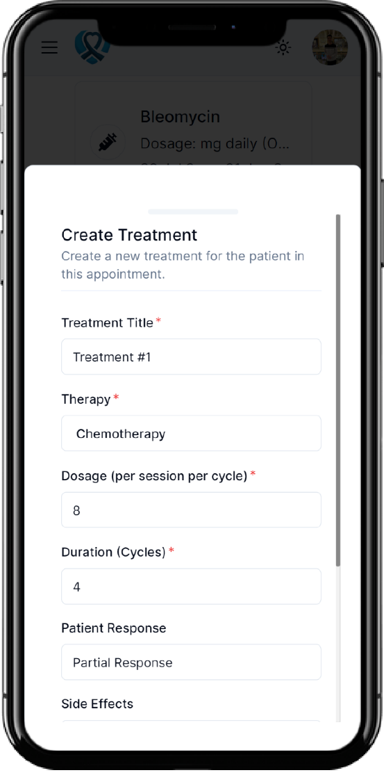
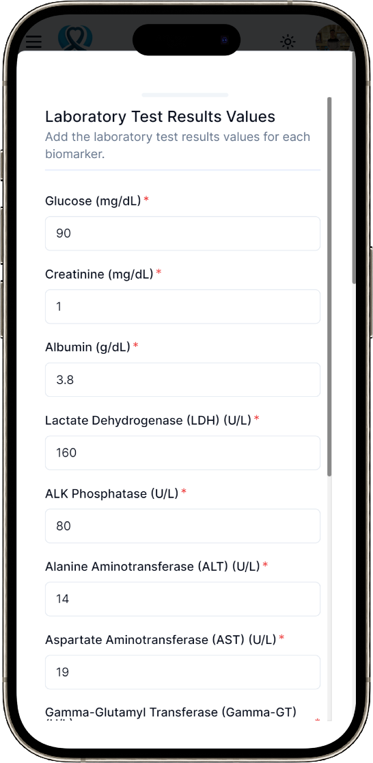
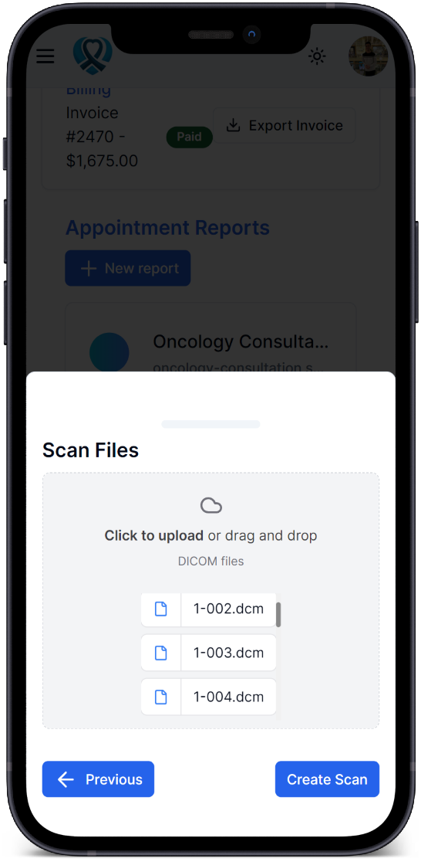
Appointments Management
Vita Clinic – Advanced Oncology Care

Slide 14
One Some More Thing(s)
Vita Clinic – Advanced Oncology Care

Slide 15
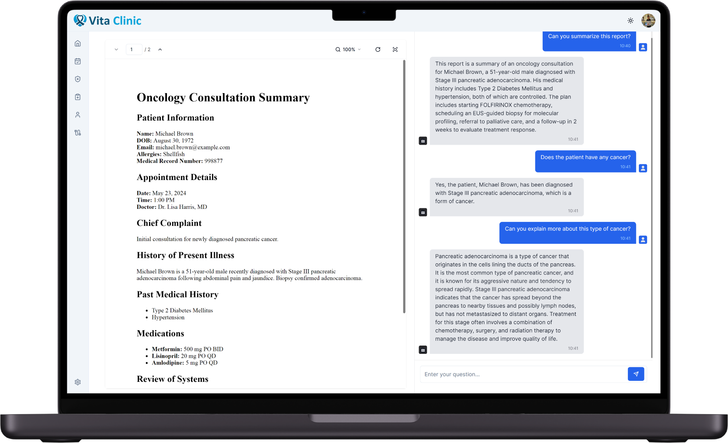
Medical Reports AI Assistant
Vita Clinic – Advanced Oncology Care

Slide 16
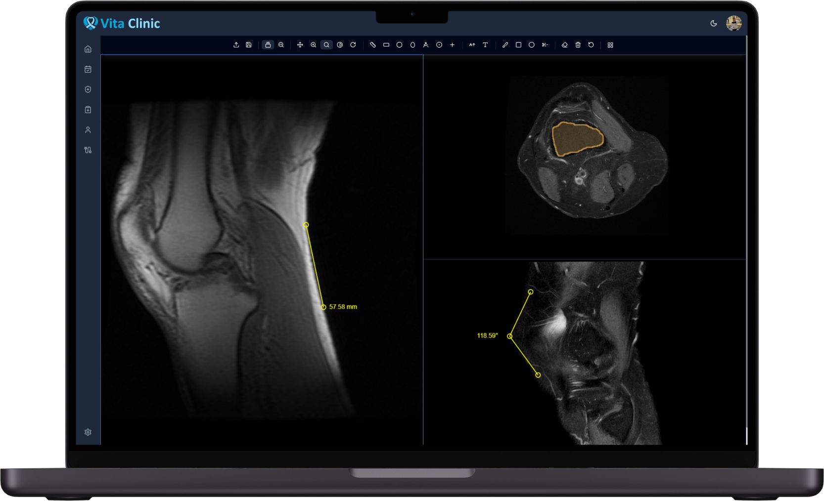
Integrated DICOM Viewer
Vita Clinic – Advanced Oncology Care

Slide 17
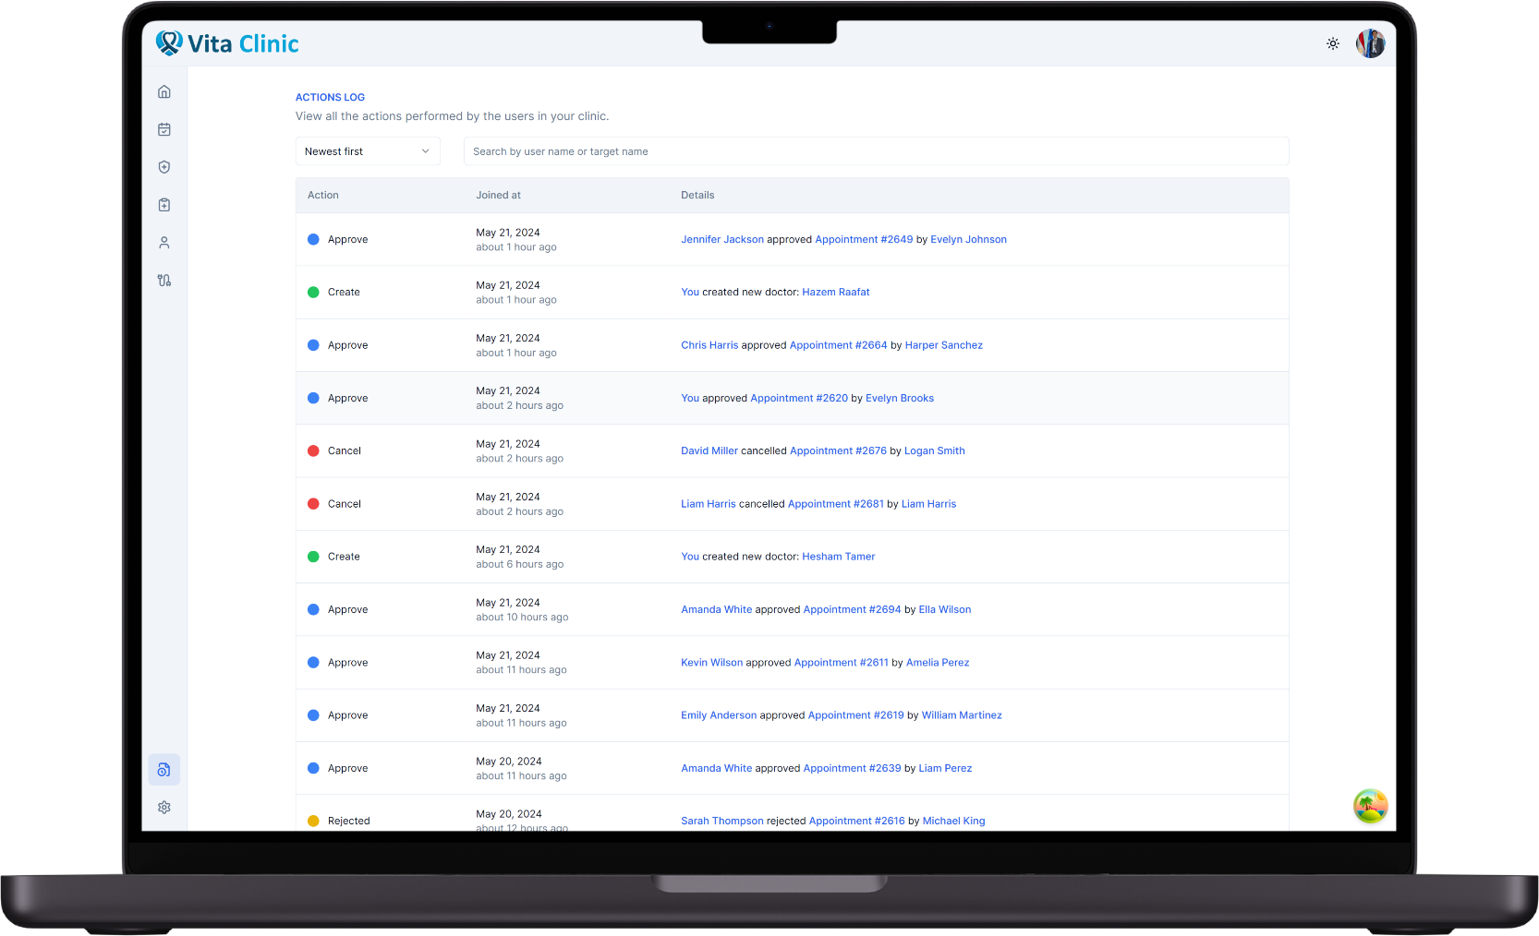
Comprehensive Actions Log
Vita Clinic – Advanced Oncology Care

Slide 18
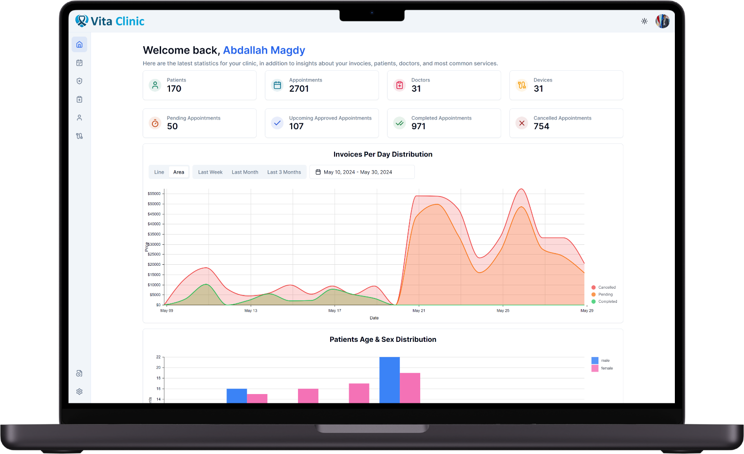
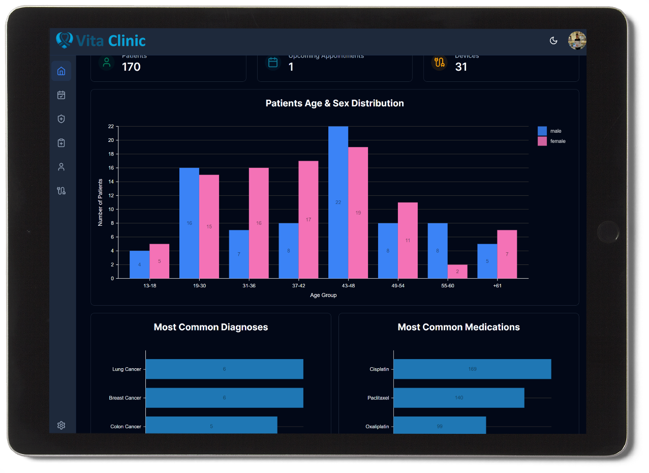
Dashboards & Insights
Vita Clinic – Advanced Oncology Care

Slide 19


















Tech Stack
Front-end
Back-end
Databases
AI Assistant
File Storage
Vita Clinic – Advanced Oncology Care

Slide 20
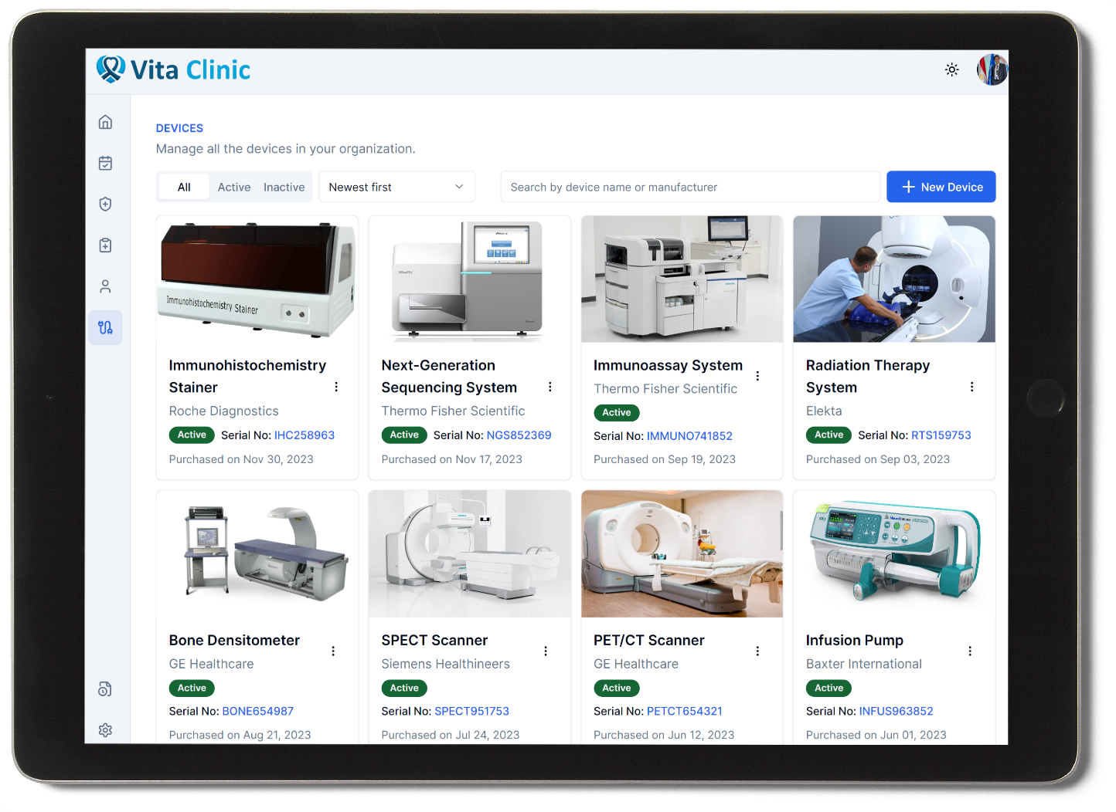
Appendix A: Devices Page
Vita Clinic – Advanced Oncology Care

Slide 21
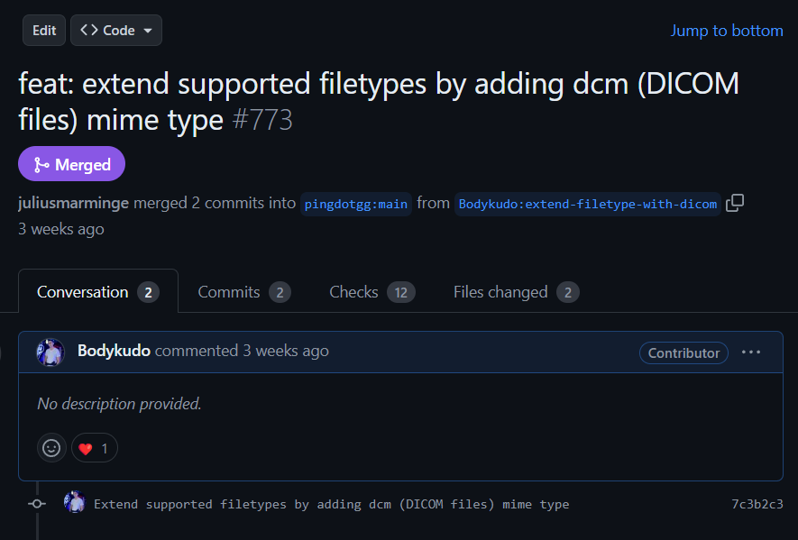
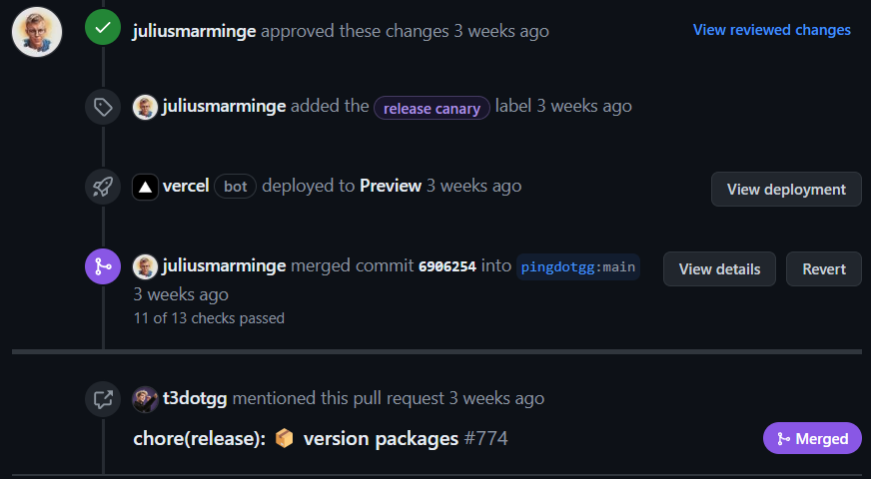
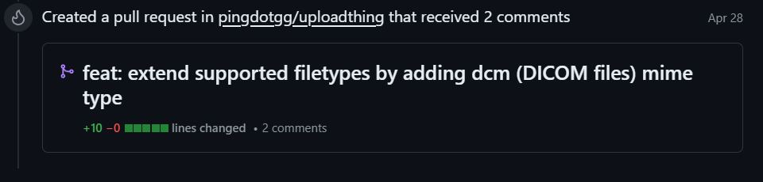
Appendix B: Open-Source Contribution
Vita Clinic – Advanced Oncology Care

Slide 22
Thank You!
Any Questions? :)
Vita Clinic – Advanced Oncology Care

